Slide 1

Predicting Personal Loan Charge offs

Slide 2
Introduction
Is it possible to predict personal loan charge offs using machine learning?
Lending Club dataset from Kaggle.
P2P loans 2007 – 2018
2.2 million rows of data
145 variables
Personal demographics and loan account data

Slide 3
Dataset Exploration
Tableau

Slide 4
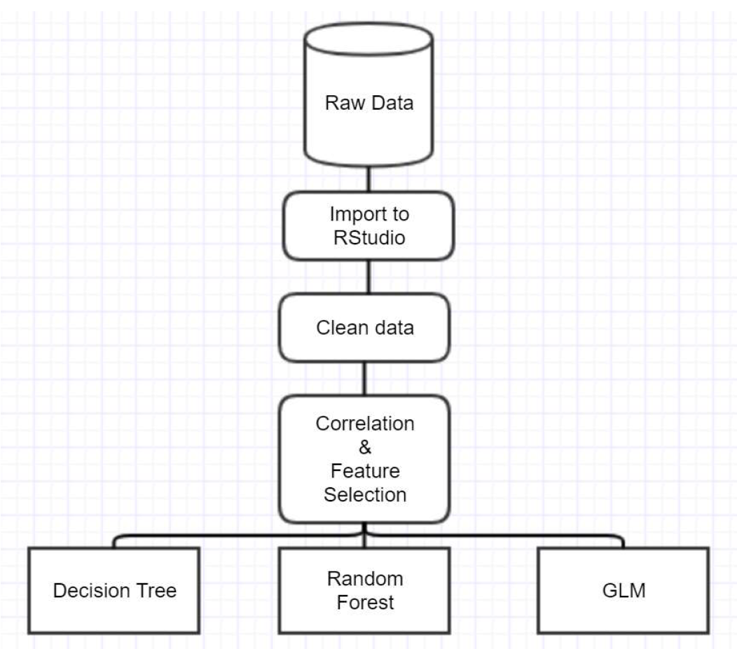
Specification & Design
Tools:
Tableau
R Studio
Classification problem
Decision Tree
Random Forest
Generalised Linear Model (GLM)

Slide 5
Demostration
R Studio

Slide 6
Conclusions
Yes, it is possible to predict charge offs using machine learning
GLM was the most accurate algorithm with 100% accuracy and 0 incorrect predictions.
Random Forest had the highest ROC at 99.99%.
Attempts to “balance” the data did not improve accuracy in this case.

Slide 7
Challenges
Data formats
Online Support

Slide 8

Questions?

